Slide 1

E-Motion Companion
Dept of Information Science & Engineering
Guided By:
Shruti J R
.
Team Members:
USN Name
1MS23IS118 Shreyas S G
1MS23IS132 Susheel Kumar
1MS23IS134 Thilak M
1MS23IS141 Varun R

Slide 2
Introduction
Real-time facial emotion recognition systems primarily detect and classify basic human emotions using camera input. However, most existing systems are developed for surveillance, monitoring, or statistical analysis rather than for direct user interaction.
This project addresses that limitation by designing an integrated system capable of:
Recognizing emotions continuously from live webcam video.
Responding with empathetic, context-aware conversational replies.
Suggesting music that aligns with the user’s emotional state.
By combining computer vision, AI-driven dialogue models, and recommendation logic, this project aims to create a more human-centric and supportive digital companion.

Slide 3
Motivation and Scope
Motivation:
In today’s fast paced environment, many individuals especially students and introverts experience stress, loneliness and emotional fluctuations but hesitate to seek help. Traditional emotional support systems are often inaccessible, non interactive, or lack personalization.
With rapid advancements in AI, there is a strong opportunity to build tools that go beyond simple emotion detection. Real time affective computing combined with conversational AI can create a digital companion that not only recognizes how a user feels, but also responds empathetically, offers comforting dialogue, and provides mood-appropriate music to regulate emotions.
This integration of computer vision, AI conversation, and personalized music recommendation addresses a major gap in existing systems making emotional support more immediate, engaging, and human centric.

Slide 4
Motivation and Scope
Scope:
Implement facial emotion detection using machine learning models (e.g., CNNs).
Generate human-like, empathetic responses using natural language models.
Enable continuous interaction where the system updates suggestions as the user’s emotions change.
Build a simple and user-friendly web interface delivering all functionalities in real time

Slide 5
Challenges and Issues
Emotion detection accuracy can be affected by poor lighting, low camera quality, or different facial angles.
Facial expressions vary from person to person, making it difficult for the model to correctly classify emotions for all users.
Real-time processing requirements may cause delays if the system is not optimized.
Limited datasets for training may reduce the accuracy of emotion recognition models.
Emotions can change quickly, making it challenging to continuously track the user's current emotional state.
Understanding complex emotions like stress or mixed emotions is difficult for AI models.
Generating empathetic chatbot responses that feel natural and supportive is challenging.
Music recommendation may not always match user preferences, since people may listen to different types of music even when they feel the same emotion.
System integration complexity, as the project combines multiple modules such as emotion detection, chatbot interaction, and music recommendation.

Slide 6
Problem Statement
Most existing real-time facial emotion recognition systems detect emotions using webcams but only display emotion labels for surveillance or monitoring purposes. Emotion-based music recommendation systems often use offline mood inputs and lack conversational, real-time interactivity. The primary motivation of this project is to build an interactive, lightweight assistant that detects user emotions in real-time via webcam, provides empathetic text responses, and suggests mood-appropriate songs. This addresses the gap where existing works do not integrate real-time emotion recognition with personalized, conversational music and text responses for user emotional support.

Slide 7
Objectives
Develop a real-time facial emotion detection module using webcam video and deep
learning techniques to classify emotions like happy, sad, angry, stressed, relaxed, and
neutral.
Create an empathetic chat module that generates supportive and context-aware
responses based on detected emotions using either fine-tuned language models or rule
based templates.
Implement a song recommendation system to suggest appropriate songs from curated
playlists mapped to detected emotions, with basic user feedback (like/dislike) to improve
suggestions.
Develop a graphical user interface that combines webcam feed, emotion detection
results, chat-bot conversation, and song suggestions.

Slide 8
Literature review
Sl No | Title of Paper & Citation Link | Methodology/ tools used | Datasets | Observation | Limitations
1. | Facial Emotion Detection Using Deep Learning: A Survey (Ansari et al., 2023) | Review of CNN, ResNet and deep learning models for facial emotion recognition | FER2013, CK+, JAFFE datasets | JAFFE datasetsDeep learning models significantly improve emotion recognition accuracy | Requires large datasets and high computational resources
2. | Advances in Facial Expression Recognition: A Survey (Kopalidis et al., 2024) | Survey of modern FER techniques including CNN and transformer models | Public facial expression datasets | Shows improvement in emotion detection using deep neural networks | Real-time performance and dataset bias remain challenges

Slide 9
Sl No | Title of Paper & Citation Link | Methodology/ tools used | Datasets | Observation | Limitations
3. | Real-Time Facial Emotion Recognition Using Deep Learning Models (IJCA, 2024) | Webcam input, OpenCV face detection, CNN classifier for emotion prediction | FER2013 dataset | Achieves real-time emotion detection suitable for interactive systems | Performance decreases under poor lighting conditions
4. | Image-Based Facial Emotion Recognition Using Deep Learning (Agung et al., 2024) | Deep CNN model for extracting facial features and classifying emotions | FER2013 and facial image datasets | CNN models effectively detect multiple emotional expressions | Requires powerful hardware for training and inference

Slide 10
Sl No | Title of Paper & Citation Link | Methodology/ tools used | Datasets | Observation | Limitations
5. | Empathetic Response Generation through Graph-Based Reasoning (Wang et al., 2021) | NLP model with graph-based reasoning to generate empathetic chatbot responses | EmpatheticDialogues dataset | Produces context-aware emotional responses in conversations | Complex model architecture increases computational cost
6. | Deep Learning-Based Emotion-Aware Chatbot with Response Generation (IJIRT, 2023) | NLP techniques and deep learning models to detect emotion and generate responses | Conversational datasets | Chatbots can provide emotional support using context-aware responses | Limited understanding of complex human emotions

Slide 11
Sl No | Title of Paper & Citation Link | Methodology/ tools used | Datasets | Observation | Limitations
7. | Chatbot Emotion Recognition and Music Recommendation System (2025) | Combines emotion detection with chatbot interaction and music recommendation | Custom conversational datasets | Demonstrates integration of chatbot communication with music suggestions | Accuracy depends on emotion recognition performanc
8. | Chatbot Music Recommendation System (ResearchGate, 2024) | Conversational chatbot integrated with recommendation algorithms | User interaction data | Improves user engagement through interactive recommendations | Limited personalization without long-term user data

Slide 12
Sl No | Title of Paper & Citation Link | Methodology/ tools used | Datasets | Observation | Limitations
9. | Emotion-Based Music Recommendation System Using Machine Learning and AI (Pardhi et al., 2024) | Machine learning classifiers map detected emotion to curated playlists | Emotion-labeled datasets and predefined song lists | Emotion-based recommendation improves listening experience | Recommendations may lack personalization
10. | Music Recommendation Based on Face Emotion Recognition (ResearchGate) | Webcam input, OpenCV face detection, CNN-based emotion classifier | FER2013 facial emotion dataset | Real-time facial emotion recognition enables automatic music suggestion | Accuracy affected by lighting conditions and facial variations

Slide 13
Sl No | Title of Paper & Citation Link | Methodology/ tools used | Datasets | Observation | Limitations
11. | Emotion-Driven Music Recommendation System (Zhao et al., 2025) | Uses emotion tags and music feature analysis (tempo, rhythm, energy) | Music emotion datasets | Aligns musical features with emotional states | Does not consider real-time emotion detection
12. | Words to Waves: Emotion-Adaptive Music Recommendation System (Arxiv, 2025) | NLP and transformer models to detect emotion from text input | Text sentiment datasets and music metadata | Emotion-aware recommendation adapts to user interaction | High computational cost for real-time systems

Slide 14
Sl No | Title of Paper & Citation Link | Methodology/ tools used | Datasets | Observation | Limitations
13. | Emotional Detection and Music Recommendation System Based on User Facial Expression (ResearchGate) | Facial emotion detection integrated with music recommendation module | Facial expression datasets | Demonstrates integration of emotion detection with recommendation system | Limited scalability and dataset diversity
14. | Music Recommendation System by Analyzing Facial Expressions (Mishra et al., 2024) | Computer vision for facial emotion detection combined with recommendation algorithm | Facial image datasets | Facial emotion recognition improves context-aware music recommendation | Limited accuracy with small datasets

Slide 15
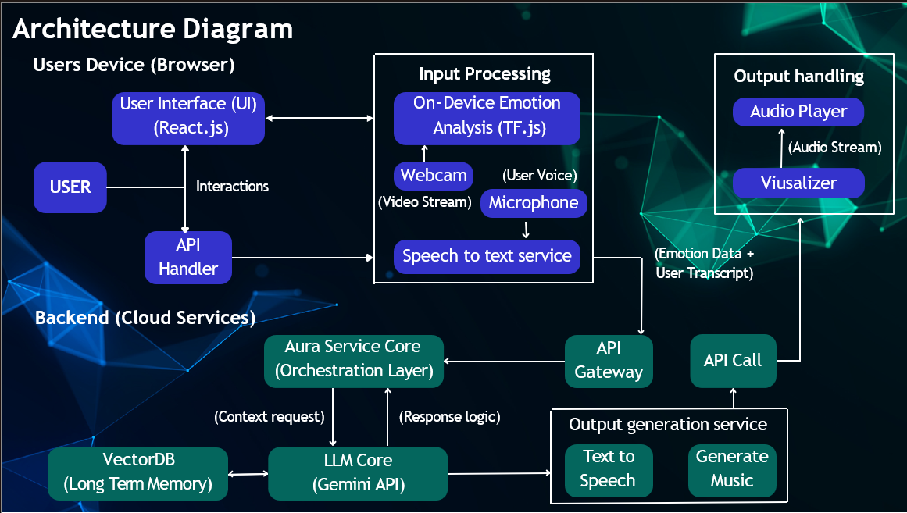
Methodology/Design

Slide 16
REFERENCES
Wijitra Montri - Development of a real-time facial emotion recognition system based on deep learning and CCTV integration - Learning-Gate Journal (2023)
Pranali Faye - Emotion Based Music Recommendation System - IJAECE, MRI India (2025)
You Wu - Emotion-based music recommendation system - EXPRESSIFY - JETIR (2025)
Shubham Kale- A Comprehensive Review of Multimodal Emotion Recognition - PubMed (2025)
MD Abdul Fahim Zeeshan- Enhancing Mental Health Interventions in the USA with Semi-Supervised Learning: An AI Approach to Emotion Prediction - Journal of Computer Science and Technology Studies(2025)

Slide 17
Thank You

